Slide 1
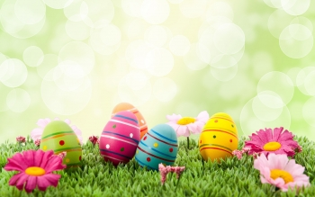
Easter
in Slovakia

Slide 2
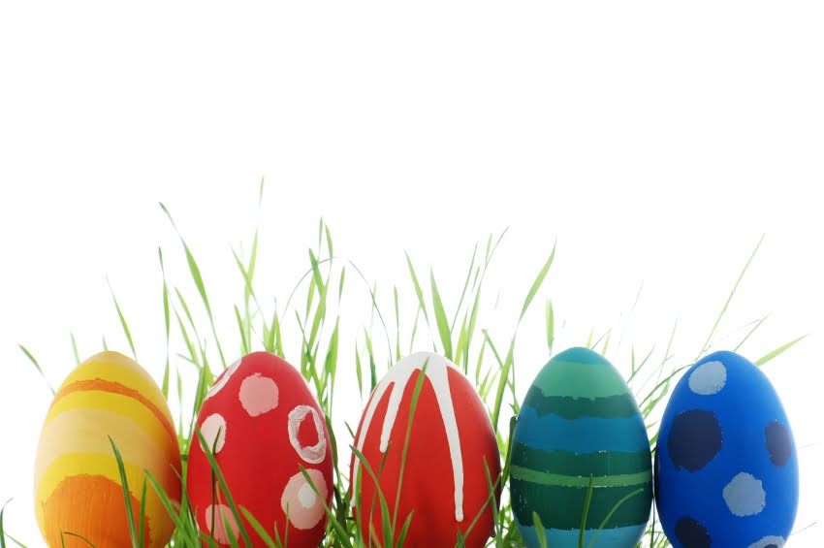
Easter is the most significant Christian holiday.
Easter celebrates the death and resurrection of Jesus Christ.
Its message is the triumph of good over evil.
Its date changes every year.

Slide 3
The term „Easter“ is not of Christian origin.
"Easter" is a form of Astarte,
the goddess
who was the queen of heaven.

Slide 4
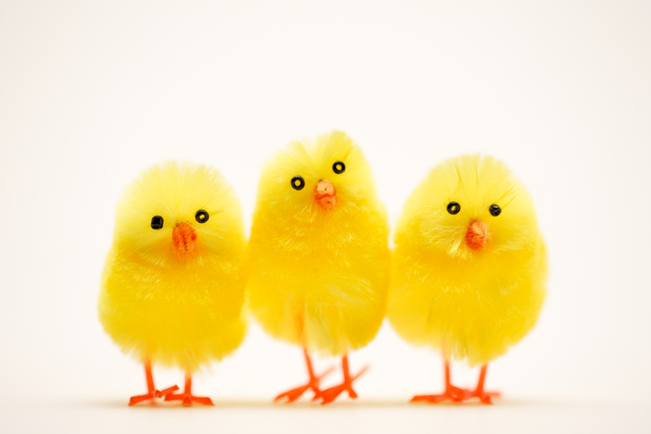
SLOVAKIA
In Slovakia are religious and cultural celebrations centred around Palm Sunday, Good Friday, Holy Saturday, Easter Sunday, and Easter Monday.

Slide 5
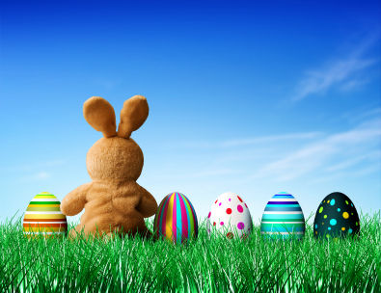
SYMBOLS
In Slovakia we have some traditional symbols of Easter:
eggs
lamb
rabbit
chick

Slide 6
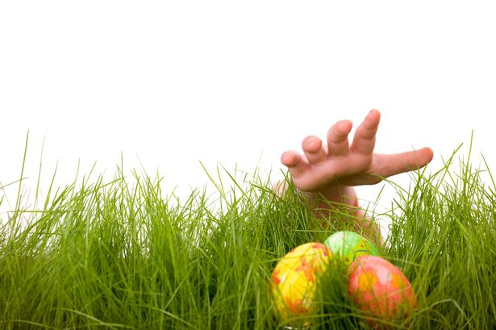
EGGS
Eggs are mythological symbol of birth.
They are Christian symbol of life and fertility.
Some eggs are hand-painted, decorated with water colors or wax.

Slide 7
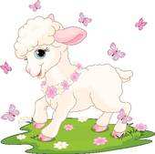
Lamb
The lamb is the most significant symbol of Easter.
It represents Jesus.
Christians traditionally refer to Jesus as "the Lamb of God“.

Slide 8
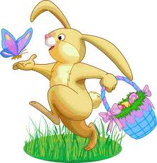
RABBIT
Rabbit is symbol of fertility
because it was
the most fertile animal
our forefathers knew.

Slide 9
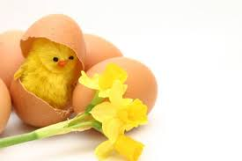
Chick
The chick symbolizes new life or re-birth.
Yellow coloured chicks
were interpreted
as the "sun" being re-born.

Slide 10
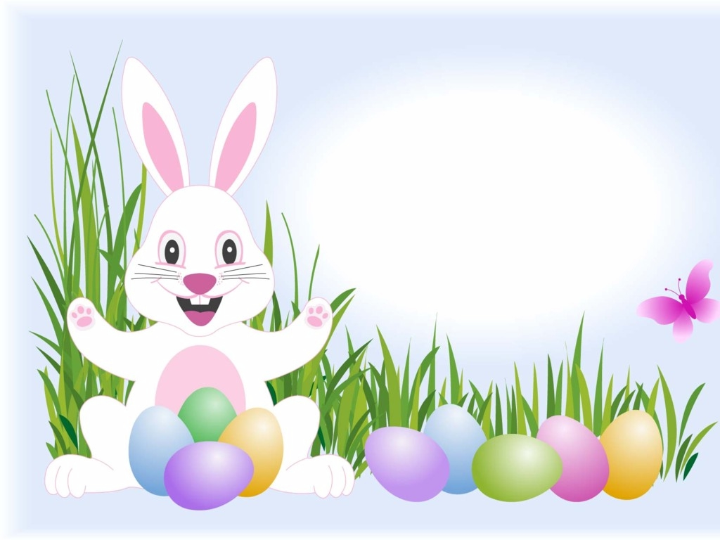
TRADITIONS

Slide 11
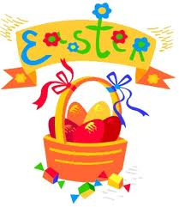
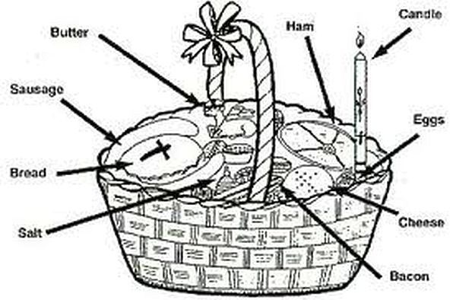
Blessing baskets
On Holy Saturday or Easter Sunday
people observe the
custom of blessing Easter Baskets.
The Baskets contain items
that are to be eaten
for the holiday
meal. Only food
is permitted
to be in the baskets.

Slide 12
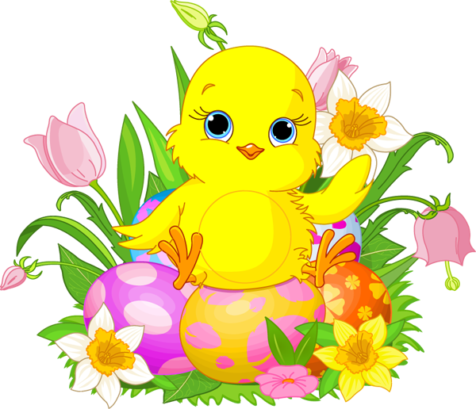
Water pouring
The young men rise early in the morning and travel to the homes of girls pouring water on them.
The water washed
away all the evils and
diseases from the body.
In some villages, boys
would throw girls
in a nearby creek.

Slide 13
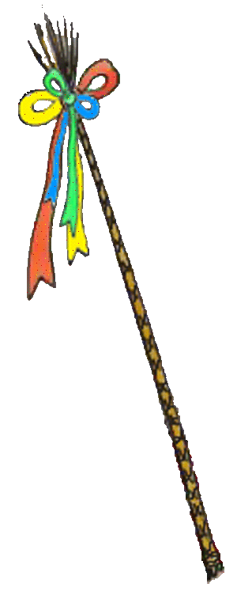
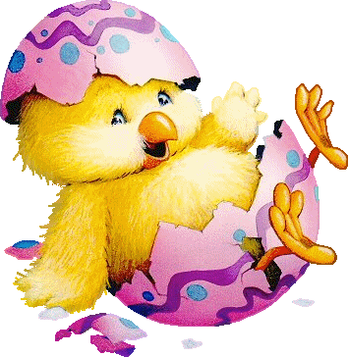
Whipping
By getting switched by whipp,
the girl would receive not only
some of the strength from the boy,
but also the health, liveliness,
and fertility.
It was believed that girls
who got whipped would get
younger, become prettier,
and also more
skilled in their daily doings.

Slide 14
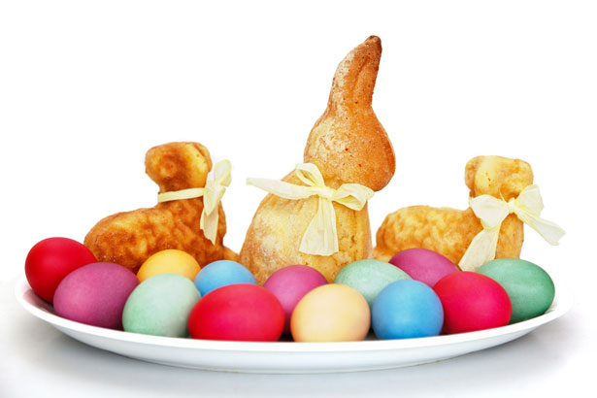
What about food?
In many families people eat
ham and eggs,
other families prepare braided raisin bread, potato salad
or baked ham.

Slide 15
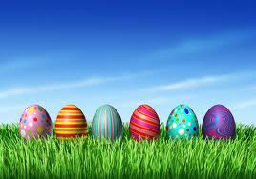
Celebrations in Slovakia This video represents traditional celebration of Easter in Slovakia:
http://www.youtube.com/watch?v=H4x-IQzlVGc

Slide 16
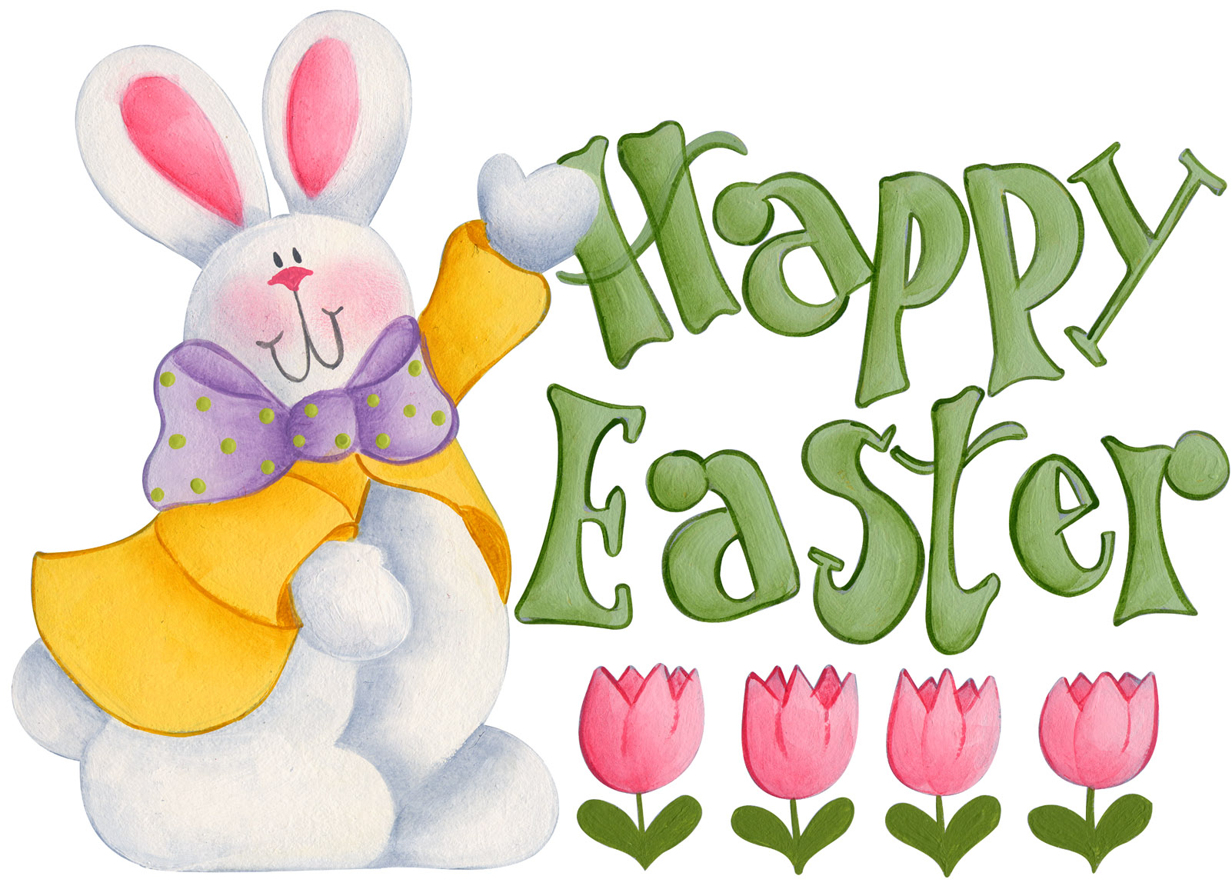

Slide 17
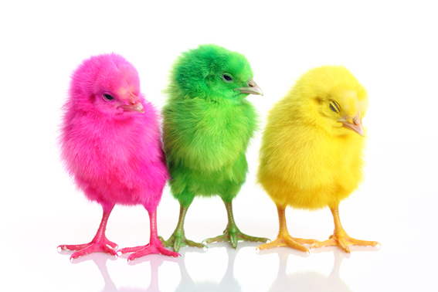
THANK YOU FOR YOUR ATTENTION
Vanesska Jerdonková

